Slide 1

Automatic Playlist Continuation
Using Spotify Million Playlist Dataset
RecSys Challenge 2018
Shrey Agarwal
Varun Saboo

Slide 2
Task
Generate a list of recommended tracks that can be added to that playlist, thereby ‘continuing’ the playlist.
Based on -
Playlist name
Songs already in the playlist

Slide 3
Motivation
With good recommendations, users stay engaged with the app for longer.
Spotify Premium users
User retention
Subscription revenue
Spotify Free users
Ad revenue.
More importantly, good recommendation = customer satisfaction.

Slide 4
Dataset
Spotify Million Playlist Dataset.
Varying length playlists with song and artist information.
Around 65 million (playlist, song) pairs. Hence it is very sparse!
Negative Sampling: We generate 4 negative samples per positive sample.

Slide 5
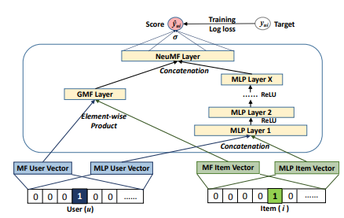
Implementation - Model 1
Neural Collaborative Filtering
Uses Neural Network
Takes MF Latent Vector and NF Latent Vector
Combines and learns to predict on (Playlist, Song) Binary Classification
Cross Entropy Loss

Slide 6
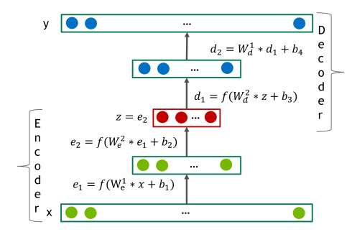

Implementation - Model 2
Deep Autoencoder Model + ANN
Input and Output are same
Input: Playlist Embedding ∈ Rn
Hidden Layers: Selu Activations
Learns latent representation by updating weights.
Used to predict for new playlists.
Loss: Cosine Embedding Loss
ANN MAP TO GET TOP K NEAREST NEIGHBOURS

Slide 7

Validation
R-precision :
Order of tracks doesn’t matter
Normalized discounted cumulative gain (NDCG) :
Measures the ranking quality of the recommended tracks
Increases when relevant tracks are placed higher in the list

Slide 8
Results
Models | Hit Rate | NDCG
Leaderboard Team 1 | 0.191566 | 0.384675
Leaderboard Team 20 | 0.159245 | 0.33208
NCF | 0.140597 | 0.280991
Autoencoder | 0.116227 | 0.24434
Our Models

Slide 9
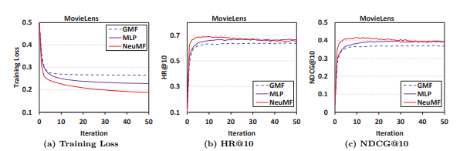
Graph for NCF
Spotify
Spotify
Spotify
0.3
0.4
0.5
0.6
0.7
0.2
0.1
.05
0
0.3
0.4
0.5
0.6
0.7
0.3
0.2
0.1
0

Slide 10
Sample Results
Original Playlist: [‘Sultans of Swing’, ‘Imagine’, ‘Thunderstruck’, ‘Back in Black’, ‘Bad Wolves’, ‘Guns N Roses-It’s so easy’,......]
Playlist Completion Recommendation: [‘Piece of Me’, ‘Over it’, ‘Your Life’, ‘Walls’, ‘Spectre’......]
As we can observe, the playlist majorly consists all rock songs and so does the recommended songs.

Slide 11
Sample Results (Contd)...
Original Playlist: [‘How we Do’, Stay Fly, Hot in Herre, ‘Got to get it’, ‘I wish’, ‘The way I am’,......]
Playlist Completion Recommendation: [‘Overnight Celebrity’, ‘Lose Yourself’, ‘Lonely’, ‘Ice Ice Baby’, ‘Hail Mary’......]
This playlist consists mix of rap and hip-hop songs and so does the recommended songs.

Slide 12
References
Deep Autoencoder: Link
NCF: Link
Collaborative Filtering: Link
NCF Reference Code: Link
Autoencoder Reference Code: Link
Spotify: Link
Leaderboard: Link
Encoder- Decoder: Link
FAISS: Link
Faster Implicit MF: Link

Slide 13
Thank You!
Open to Questions/Suggestions!

